Slide 1
Interrupt Control and System Control

Slide 2
Overview
NVIC and System Control Block
Interrupt Enable and Clear Enable
Example to Enable and clear interrupt #2
Interrupt Pending and Clear Pending
Example to trigger pending and clear pending on interrupt #2
Interrupt Priority Level
Example to set the priority of level of interrupt #2 to 0xC0
Exception Masking Register

Slide 3
NVIC features
Flexible interrupt management include enable/disable, priority configurations
• Hardware nested interrupt support
• Vectored exception entry
• Interrupt masking

Slide 4
Overview of the NVIC and System Control Block
The NVIC in the Cortex-M0 processor supports up to 32 external interrupts and one nonmaskable interrupt (NMI).
The interrupt input requests can be level triggered, or they can be pulsed with a minimum of one clock cycle.
Each external interrupt can be enabled or disabled independently, and its pending status can also be set or clear manually.
The NVIC control registers are memory mapped and can be easily accessed in C language.
The location of the NVIC registers starts from address 0xE000E100. For the Cortex-M0 processor, the accesses to the NVIC register must be in word size.
Similar to the NVIC registers, the SCB registers are also word accessible, and the address starts from 0xE000E010.
The SCB registers handle features like the SysTick timer operations, system exception management and priority control, and sleep mode control.

Slide 5
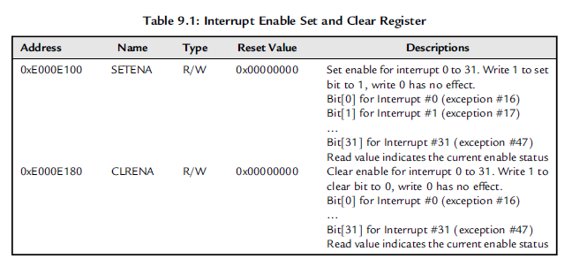
Interrupt Enable and Clear Enable

Slide 6
Interrupt Enable and Clear Enable To Enable interrupt #2
NVIC with one access:
*((volatile unsigned long *)(0xE000E100))=0x4; //Enable interrupt #2
Assembly
LDR R0,=0xE000E100 ; Setup address in R0
MOVS R1,#0x4 ; interrupt #2
STR R1,[R0] ; write to set interrupt enable
CMSIS
void NVIC_EnableIRQ(IRQn_Type IRQn);
// Enable Interrupt // IRQn value of 0 refer to Interrupt #0

Slide 7
Interrupt Enable and Clear Enable To Disable interrupt #2
NVIC with one access:
*((volatile unsigned long *)(0xE000E180))=0x4; //Enable interrupt #2
Assembly
LDR R0,=0xE000E180 ; Setup address in R0
MOVS R1,#0x4 ; interrupt #2
STR R1,[R0] ; write to set interrupt enable
CMSIS
void NVIC_DisableIRQ(IRQn_Type IRQn);
// Disable Interrupt // IRQn value of 0 refer to Interrupt #0

Slide 8
Interrupt Pending and Clear Pending
If an interrupt takes place but cannot be processed immediately ,for example, if the processor is serving a higher-priority interrupt ,the interrupt request will be pended.
The pending status is held in a register and will remain valid until the current priority of the processor is lowered so that the pending request is accepted or until the application clears the pending status manually.
The interrupt pending status can be accessed or modified, through the Interrupt Set Pending (SETPEND) and Interrupt Clear Pending (CLRPEND) register addresses (Table 9.2).
Similar to the Interrupt Enable control register, the Interrupt Pending status register is physically one register, but it uses two addresses to handle the set and clear the bits.

Slide 9
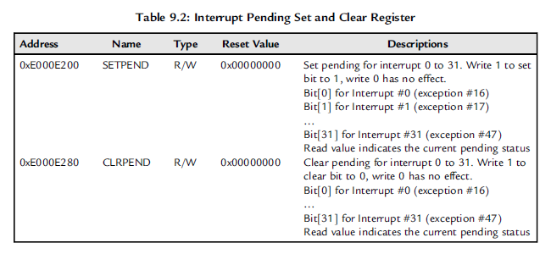
Interrupt Pending and Clear Pending

Slide 10
Interrupt Pending and Clear Pending to trigger interrupt #2
NVIC
*((volatile unsigned long *)(0xE000E100))=0x4; //Enable interrupt #2
*((volatile unsigned long *)(0xE000E200))=0x4; //Pend interrupt #2
Assembly
LDR R0,=0xE000E100 ; Setup address in R0
MOVS R1,#0x4 ; interrupt #2
STR R1,[R0] ; write to set interrupt enable
LDR R0,=0xE000E200 ; Setup address in R0
STR R1,[R0] ; write to set pending status
CMSIS
void NVIC_SetPendingIRQ(IRQn_Type IRQn); // Set pending status of a interrupt

Slide 11
Interrupt Pending and Clear Pending to clear interrupt #2
NVIC
*((volatile unsigned long *)(0xE000E280))¼0x4;// Clear interrupt #2
// pending status
Assembly
LDR R0,=0xE000E280 ; Setup address in R0
MOVS R1,#0x4 ; interrupt #2
STR R1,[R0] ; write to clear pending status
CMSIS
void NVIC_ClearPendingIRQ(IRQn_Type IRQn); // clear pending status of a interrupt

Slide 12
Interrupt Priority Level
Each external interrupt has an associated priority-level register.
Each of them is 2 bits wide, occupying the two MSBs of the Interrupt Priority Level Registers.
Each Interrupt Priority Level Register occupies 1 byte (8 bits).
NVIC registers in the Cortex-M0 processor can only be accessed using word-size transfers, so for each access, four Interrupt Priority Level Registers are accessed at the same time (Figure 9.1).
The unimplemented bits are read as zero. Write values to those unimplemented bits are ignored, and read values of the unimplemented bits return zeros (Table 9.3).

Slide 13
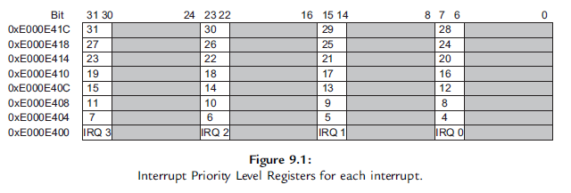
Interrupt Priority Level

Slide 14
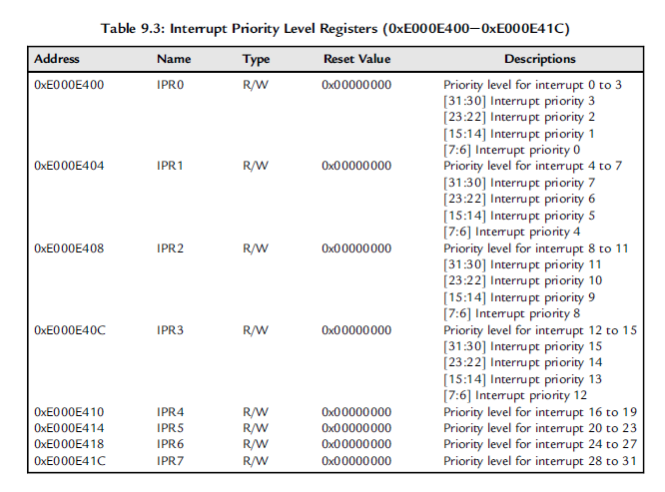
Interrupt Priority Level

Slide 15
Interrupt Priority Level
For example, if we want to set the priority level of interrupt #2 to 0xC0, we can do it by using the following code:
NVIC
unsigned long temp; // a temporary variable
temp = *((volatile unsigned long *)(0xE000E400)); // Get IPR0
temp = temp & (0xFF00FFFF) j (0xC0 << 16); // Change Priority level
*((volatile unsigned long *)(0xE000E400)) = temp; // Set IPR0

Slide 16
Interrupt Priority Level
For example, if we want to set the priority level of interrupt #2 to 0xC0, we can do it by using the following code:
Assembly
LDR R0,=0xE000E400 ; Setup address in R0
LDR R1,[R0] ; Get PRIORITY0
LDR R2,=0x00FF0000 ; Mask for interrupt #2’s priority
BICS R1, R1, R2 ; R1 = R1 AND (NOT(0x00FF0000))
LDR R2,=0x00C00000 ; New value for interrupt #2’s priority
ORRS R1, R1, R2 ; Put new priority level
STR R1,[R0] ; write back value

Slide 17
Interrupt Priority Level
For example, if we want to set the priority level of interrupt #2 to 0xC0, we can do it by using the following code:
CMSIS-compliant device driver libraries, the interrupt priority level can be accessed by two functions:
void NVIC_SetPriority(IRQn_Type IRQn, uint32_t priority); // Set the priority
// level of an interrupt or a system exception
uint32_t NVIC_GetPriority(IRQn_Type IRQn); // return the priority
// level of an interrupt or a system exception

Slide 18
Interrupt Priority Level
Note that these two functions automatically shift the priority level values to the implemented bits of the priority level registers.
Therefore, when we want to set the priority value of interrupt #2 to 0xC0,
we should use this code:
NVIC_SetPriority(2, 0x3); // priority value 0x3 is shifted to become 0xC0

Slide 19
Exception Masking Register (PRIMASK)
In some applications, it is necessary to disable all interrupts for a short period of time for time critical processes.
Instead of disabling all interrupts and restoring them using the interrupt enable/disable control register, the Cortex-M0 processor provides a separate feature for this usage.
One of the special registers, called PRIMASK can be used to mask all interrupts and system exceptions, apart from the NMI and hard fault exceptions.

Slide 20
Exception Masking Register (PRIMASK)
The PRIMASK is a single bit register and is set to 0 at reset.
When set to 0, interrupts and system exceptions are allowed.
When set to 1, only NMI and hard fault exceptions are allowed.
Effectively, when it is set to 1, it changes the current priority level to 0.
Set or clear the PRIMASK register using the MSR instruction.
MOVS R0, #1 ; New value for PRIMASK
MSR PRIMASK, R0 ; Transfer R0 value to PRIMASK

